Slide 1




Business analyTICS final project Group 2
ABC WIRELESS

Slide 2

NAMES | CONTRIBUTIONS
GLORIA STEPHEN | REPORT, R CODE
AKSA TANIYA | PRESENTATION , REPORT
NIKITHA CHIGURUPATI | R CODE , REPORT
SARIDINDU KARLAPALEM | R CODE , REPORT

Slide 3
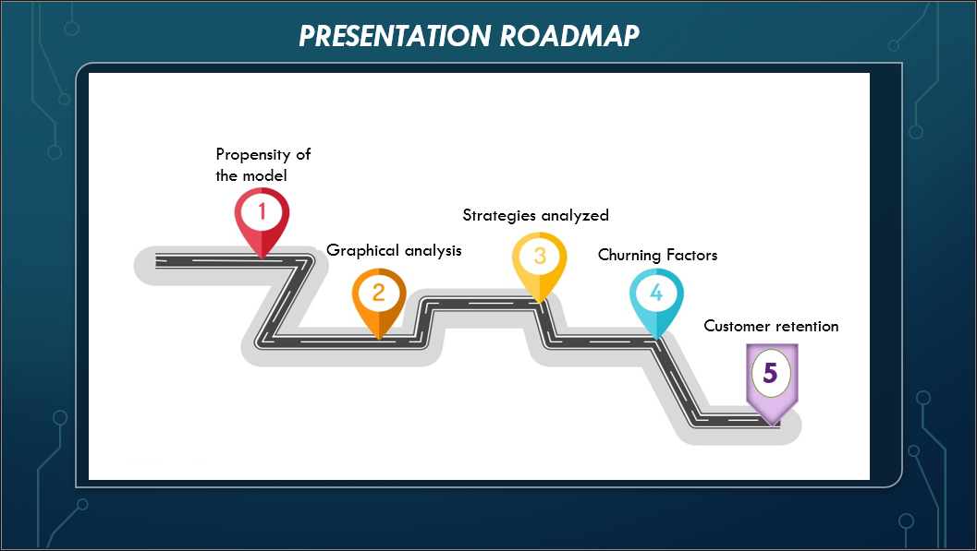

Slide 4
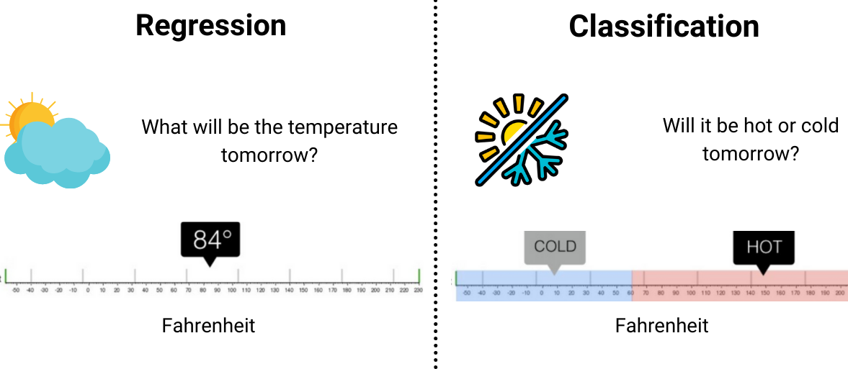
Propensity of THE model

Slide 5
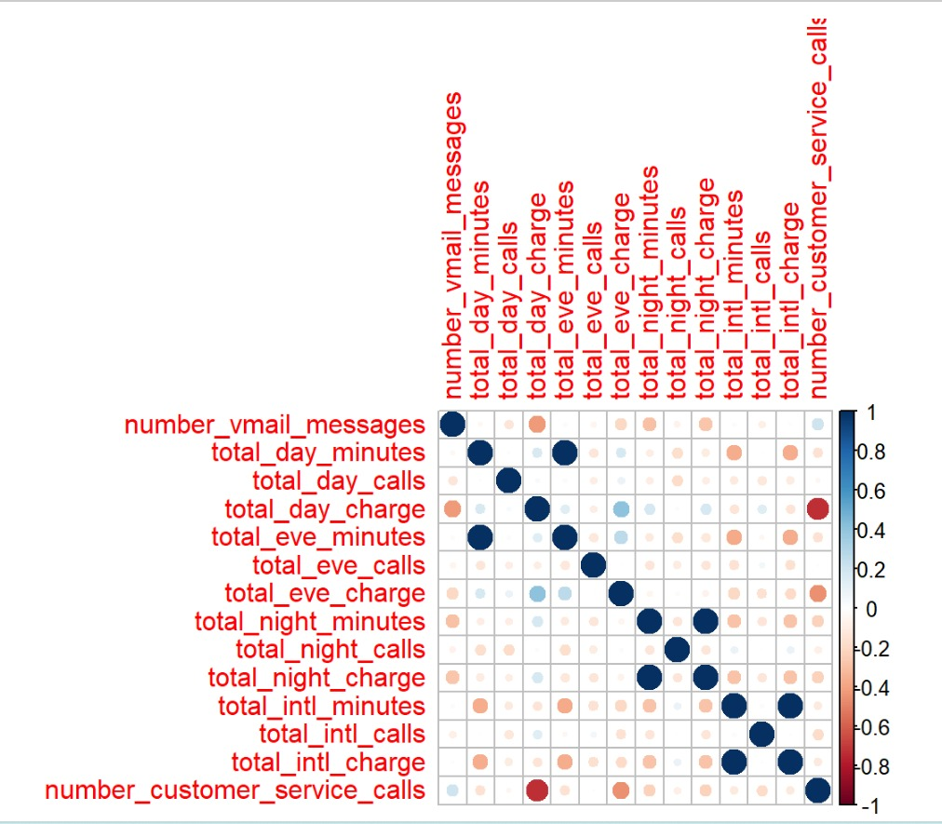
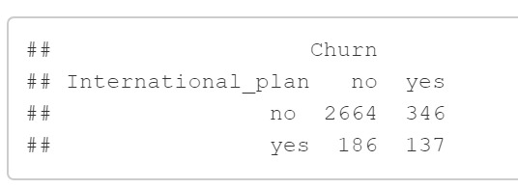
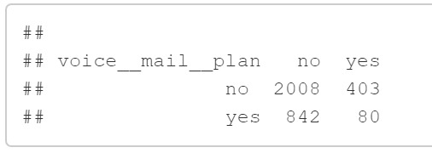

CORRELATION AND 2 WAY TABLE
Positive Correlation-
Total day minutes & total eve minutes
Total night calls & total night charges
Total intl calls & total intl charge
Negative Correlation-
Number of service calls & Total day charge
28% of customers are lost by the International plan and 16% of customers are lost by the voice mail plan

Slide 6
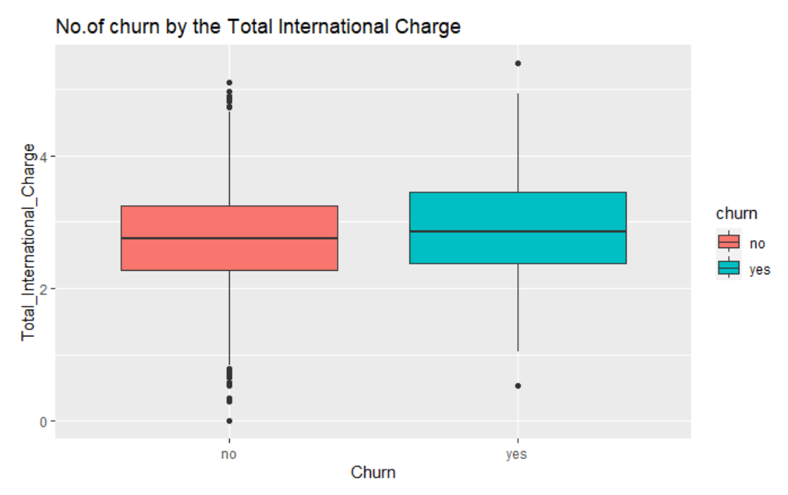
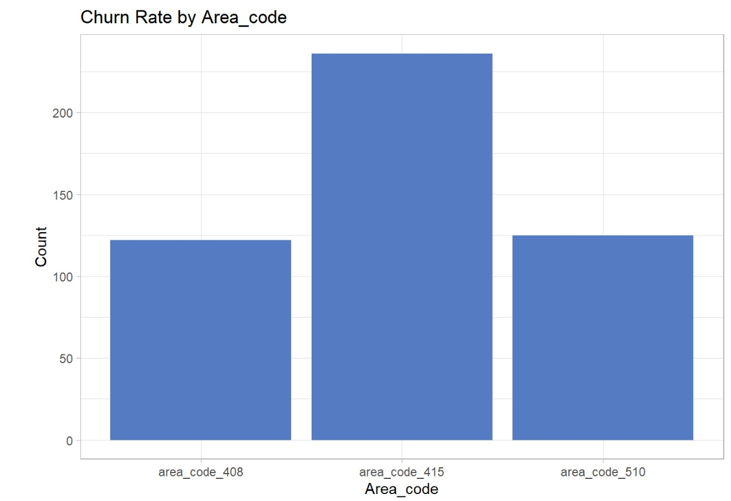
BOX PLOT & BAR PLOT

Slide 7
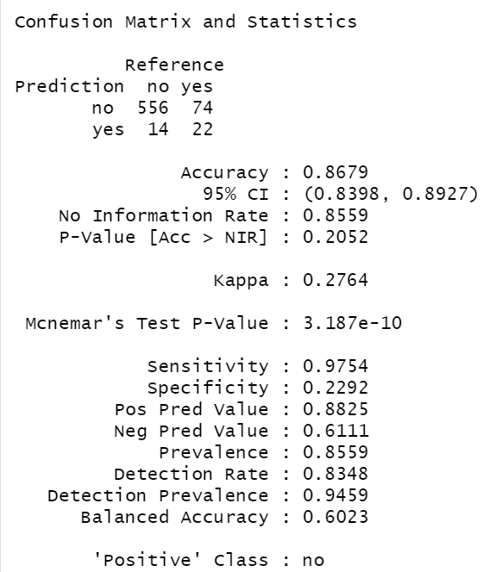
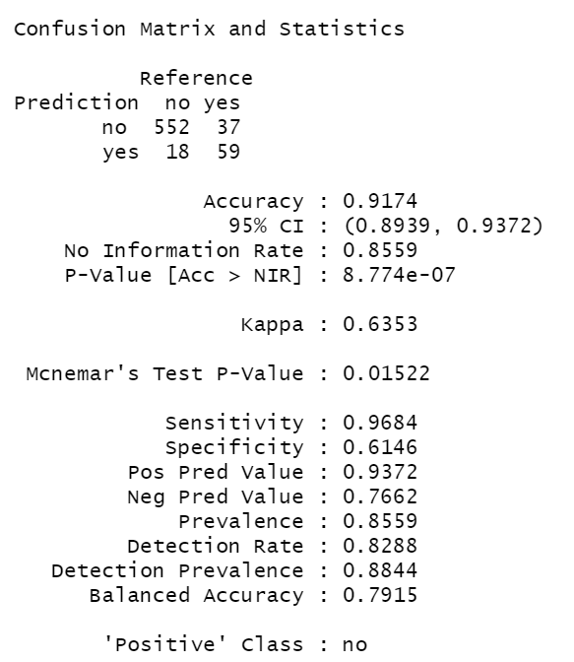
STRATEGIES ANALYSED
LOGISTIC REGRESSION
DECISION TREES

Slide 8

CAUSES OF CHURNING
Inefficient customer service
Poor Network quality
Better plans offered by the competitors

Slide 9


CustomerS RETENTION
Segmentation on basis of customer plan
Acquisition strategy for churned customers
Customers feedback

